Slide 1

Scrum Master Training
Chandresh Patel (CSM)
M.D. Bacancy Technology
www.bacancytechnology.com
www.pmpcoaching.com
www.scrumindia.in

Slide 2
INTRODUCTIONS

Slide 3
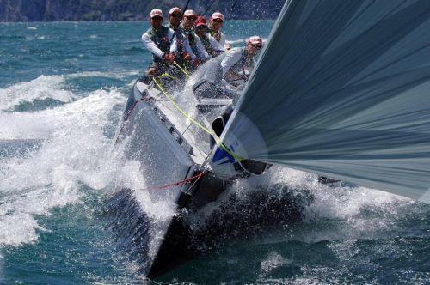
“The quality of leadership, more than any other single factor, determines the success or failure of an organization.”
(Source: Fred Fiedler & Martin Chemers Improving Leadership Effectiveness )

Slide 4
Agenda
The Scrum Master’s Mission
The Responsibilities of the Scrum Master
Beyond the Mechanics
Characteristics of the Scrum Master
Role of the Scrum Master
Resources
Q & A

Slide 5
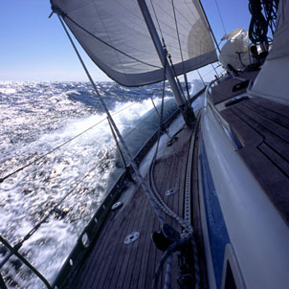
The Scrum Master’s Mission
Guide your team to optimum performance

Slide 6

Ideal Scrum Team
5 – 9 people
Cross-discipline
Anyone can take any task
Perfect coordination
All their time is devoted to one project
Constant and effective communication with the Product Owner (Customer)
Continuously improving their performance
Always delivering what is committed to
Healthy conflict

Slide 7
The Responsibilities of the Scrum Master
Sprint Planning Meetings
Daily Scrums
Sprint Demos
Sprint Retrospectives
Backlog Preparation
Remove Impediments
Protect the Team
Protect the Process
Coaching

Slide 8
Exercise
Groups of 4 or 5 people
5 minutes
Answer this question: “What are the characteristics and qualities of a successful Scrum Master?”

Slide 9
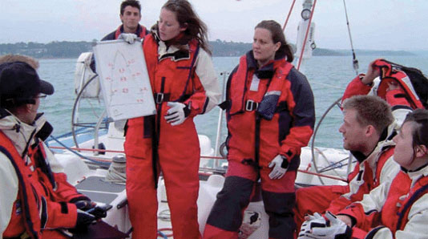
Sprint Planning Meetings
Schedule these meetings well in advance
Stick to 4 hour time boxes at first
Facilitate these meetings
Ensure the outputs from these meetings are updated (Product Backlog, Sprint Backlog)

Slide 10
Sprint Planning Meeting #1
Goal: Team selects the highest priority items from the Product Backlog to be completed in the Sprint.
Preparation:
Prioritized Product Backlog
Highest priority stories are “right-sized” stories
Know or calculate the velocity of your team
Ensure Product Owner or proxy will be at this meeting
Ensure all team members will be at this meeting
Output – Sprint Goal, Accepted User Stories
Updates to user stories (changes, additions, deletions)
Updated Poker estimates for user stories
Updated Sprint # for stories the team will take into the Sprint

Slide 11
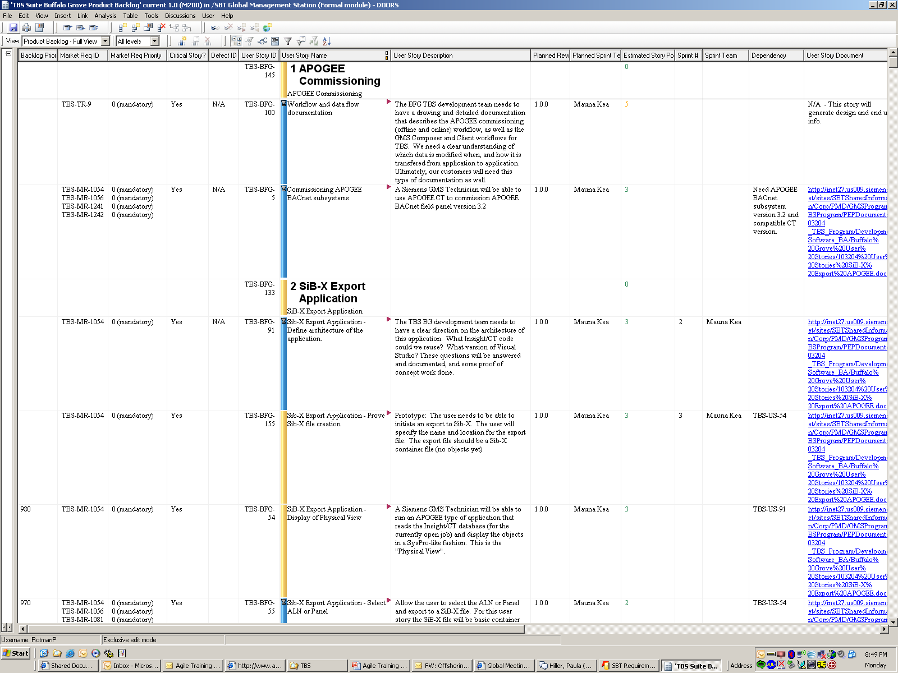
Sprint Planning Meeting #1 – Product Backlog

Slide 12
Sprint Planning Meeting #1 – Facilitation
This is a working meeting. Plan to spend the greatest amount of time discussing the user stories and possibly modifying some
Tips on facilitating this meeting:
  Teams can get “stuck” in the estimation process – help them get “unstuck”
  Capture important conversations in the User Story document
  Ensure all disciplines are being represented
  Make sure there is a common understanding of the user stories
Notes:
Talk about why it is important to get to a common understanding of the user stories. Clarifying questions now will save time in the long run. Don’’t try to short-change the time on this meeting. This is not the place in the project to save time. Pay now, or pay more later.

Slide 13
Sprint Planning Meeting #2
Goal: Team creates tasks with “ideal” hour estimates for each story selected for the Sprint.
Preparation:
Ensure that all team members will be at this meeting
Prepare a Sprint Backlog template for the sprint (if using an electronic backlog)
Verify availability of team members for this sprint
Output – Sprint Backlog:
Stickies and/or electronic backlog, populated with tasks for each user story
Updated Product Backlog, if anything changed

Slide 14
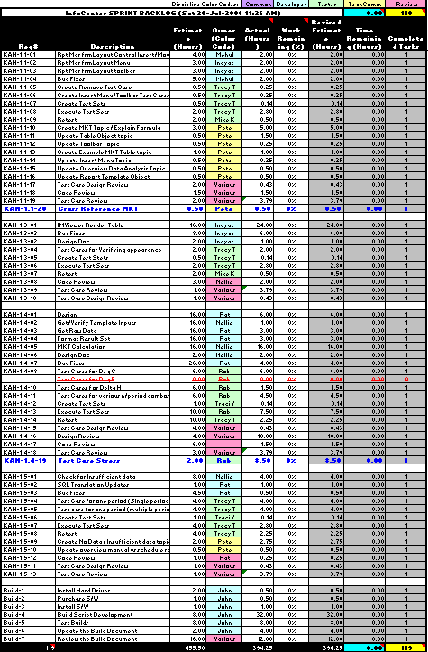
Sample Sprint Backlog
Req# | Description | Est. (Hrs) | Owner (Color Code) | Act (Hrs) | Work Remaining (%)
KAN-1.1-01 | Rpt Mgr frmLayout Control Insert/Move | 4.00 |  |  | 100%
KAN-1.1-02 | Rpt Mgr frmLayout Menu | 3.00 |  |  | 100%
KAN-1.1-03 | Rpt Mgr frmLayout toolbar | 3.00 |  |  | 100%
KAN-1.1-04 | Bug Fixes | 5.00 |  |  | 100%
KAN-1.1-05 | Create Remove Test Case | 0.50 |  |  | 100%
KAN-1.1-06 | Create Insert Menu/Toolbar Test Cases | 0.50 |  |  | 100%
KAN-1.1-07 | Create Test Sets | 0.50 |  |  | 100%
KAN-1.1-08 | Execute Test Sets | 2.00 |  |  | 100%
KAN-1.1-09 | Retest | 2.00 |  |  | 100%
KAN-1.1-10 | Create MKT Topic / Explain Formula | 3.00 |  |  | 100%
KAN-1.1-11 | Update Table Object topic | 0.50 |  |  | 100%
KAN-1.1-12 | Update Toolbar Topic | 0.50 |  |  | 100%
KAN-1.1-13 | Create Example MKT Table topic | 1.00 |  |  | 100%
KAN-1.1-14 | Update Insert Menu Topic | 0.50 |  |  | 100%
KAN-1.1-15 | Update Overview Data Analysis Topic | 0.50 |  |  | 100%
KAN-1.1-16 | Update Report Template Object | 0.50 |  |  | 100%
KAN-1.1-17 | Test Case Design Review | 2.00 |  |  | 100%
KAN-1.1-18 | Code Review | 1.50 |  |  | 100%
KAN-1.1-19 | Test Case Review | 2.00 |  |  | 100%
KAN-1.1-20 | Cross Reference MKT | 0.50 |  |  | 100%
Detailed Estimates
Note: For geographically diverse teams, this may be the only tool for monitoring the Sprint Backlog.
Notes:
Show Exploded view from entire chart

Slide 15
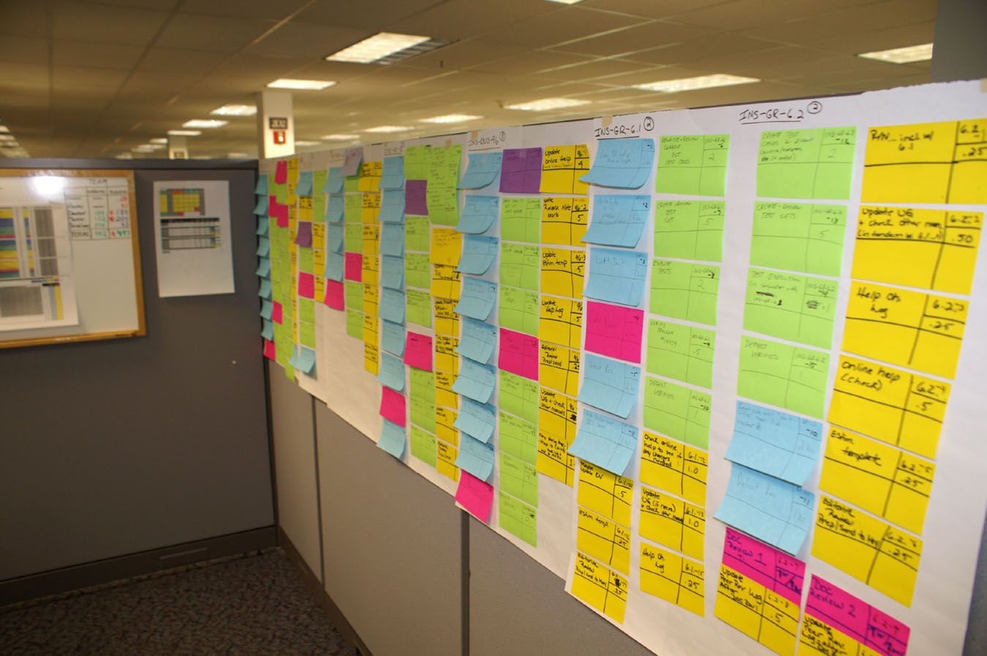
Sprint Task Cards

Slide 16
Sprint Planning Meeting #2 – Facilitation
Help the team break down tasks that are too big (16 hours max)
Keep a running total of effort that is being estimated, so the team will know when they are at capacity
Guide the team in decisions if the detailed estimates don’t match the Poker estimates
Encourage collaboration between the disciplines during task breakdown
Encourage team to consult with the Product Owner if needed
Avoid taking short-cuts – this is a “team” not a group of individual contributors.
Help team members who may find this process threatening
Stickies first or electronic backlog first?
Bring snacks!
Notes:
Talk about how the goal of this meeting is not to get through it a quickly as possible. You lose a lot if people don’t work together on the tasking out. Things WILL get missed when not discussed as a group.

Slide 17
Exercise
Groups of 4-5 people
5 minutes
If you are the Scrum Master, describe how you would handle the following situation and why?
Case Study A:
You are in Sprint Planning Meeting #1. The two stories on the top of the backlog are each sized at a 13. Your team has a velocity of 21 points. The Product Owner really wants both stories as soon as possible and asks the team to take both into the sprint.

Slide 18
Exercise
Groups of 4-5 people
5 minutes
If you are the Scrum Master, describe how you would handle the following situation and why?
Case Study B:
You are one hour into Sprint Planning Meeting #2. Your tech writer has already identified all of the tasks he would have to do for the stories the team has taken and wants to leave early.

Slide 19
Daily Scrums
Goal: Each team member should answer the following three questions in some fashion…
What sprint work did you accomplish yesterday?
What sprint work will you accomplish tomorrow?
What impediments do you have?
Purpose:
Coordination
Accountability

Slide 20
Daily Scrums - Facilitation
View the sprint burndown chart as a team
Start on time
Time-box to 15 minutes
Have absent member call into the meeting (conference phone)
Halt side conversations
Maintain the balance between status and coordination
Allow people to take their own work
Encourage team behavior
If the Sprint is off course, guide the team through decisions that need to be made (may need to meet later to analyze the problem)
Uncover unspoken impediments
Keep the sprint backlog up to date at each meeting
FOCUS is key!
“The Main Thing is to keep the Main Thing the Main Thing” –Steven Covey
Notes:
Keep the focus!

Slide 21
Exercise
Groups of 4-5 people
5 minutes
If you are the Scrum Master, describe how you would handle the following situation and why?
Case Study C:
Most team members are grumbling that the daily standup meetings are a big waste of time. They don’t have an hour to spend each day on a status meeting. They suggest doing the meeting only once (twice at the most) per week.

Slide 22
Sprint Demos
Goals: Show the working product
Output: Accepted Increment, Updated Product Backlog
Facilitation:
Schedule this meeting (day after last day of sprint)
Ensure Product Owner or proxy will attend
Invite stakeholders (Field Support, Training, Management, etc.)
Remind the team to prepare for this meeting, e.g.
  Determine who will demo what stories
  Prepare and test final build prior to demo
Document feedback from the Product Owner and stakeholders
If changes are requested, agree how to manage them (new story, DCS, etc.)

Slide 23
Sprint Retrospectives
Goal: Inspect and adapt
Output: Course Correction
Preparation: Review artifacts of the sprint
Facilitation:
Inspect
  Show the team their artifacts (Sprint burndown, DCSs, etc.)
  Follow a basic template or invent your own
  Keep it simple; ask broad questions
  Document the key points
Adapt
  Agree on one or two things the team will do differently
  “Excellence is not an accomplishment. It is a spirit, a never-ending process.”
  - Lawrence M. Miller
Notes:
Estimates vs. actuals can be used in a positive way!

Slide 24
Sprint Retrospective Template
Sprint Demo & Retrospective
Project:
Sprint:
Team:
Date:
Attendees:
Demo Feedback:
Product Owner overall satisfaction:
(Scale of 1 – 10, 10 being delighted)
Review of Sprint Artifacts:
Story points planned:
Story points completed:
Major Impediments:
Critical defects still open?
Sprint goal achieved?
Sprint Success/Fail?

Slide 25
Exercise
Groups of 4-5 people
5 minutes
If you are the Scrum Master, describe how you would handle the following situation and why?
Case Study D:
Your testers have mentioned (for the third retrospective in a row) that the developers are coding right up to the end of the sprint. They are not having enough time to do their testing tasks in the sprint. They suggest that the features developed in one sprint should be tested in the following sprint. It’s just too hard to get it all done in one sprint.

Slide 26
Exercise
Groups of 4-5 people
5 minutes
If you are the Scrum Master, describe how you would handle the following situation and why?
Case Study E:
Your team has failed the past 5 sprints in a row. They don’t really seem to care. Morale is at an all-time low. They know that if they don’t finish all the tasks for a particular user-story, it will just be rolled over into the next sprint.

Slide 27
Exercise
Groups of 4-5 people
5 minutes
If you are the Scrum Master, describe how you would handle the following situation and why?
Case Study F:
You are in the Sprint Retrospective and your tech writer has called out that the team made more changes than they had anticipated for one of the stories, so the documentation is incomplete. The developers are confused because they know that the design hasn’t changed since Sprint Planning Meeting #2…which the Tech Writer left early from.

Slide 28
Backlog Preparation
Work with the team, Project Leader, and Product Owner to determine how initial and ongoing Backlog preparation will be done.
X number of user stories ready to go for each sprint (at least 2X sprint team’s velocity)
Right-sized user stories

Slide 29
Sample Product Backlog
User Story | Size
A | 40
B | 8
C | 3
D | 2
E | 20
F | 13
G | 100
H | 3
I | 2
J | 5
K | 1
L | 5
M | 1
User Story | Size
N | 2
O | 8
P | 13
Q | 5
R | 2
S | 5
T | 20
U | 1
V | 8
W | M
X | L
Y | M
Z | S
Page <number>

Slide 30
Remove Impediments
Know the difference between impediments and excuses
Track impediments during the sprint. Review at each daily scrum.
Teams can “impeed” themselves (depending on each other for things)… but does this really count?
Be prepared to do organizational battle
  Part-time team members
  Red tape
  Dependencies between other pojects
Notes:
Impediments are outside the team’s control

Slide 31
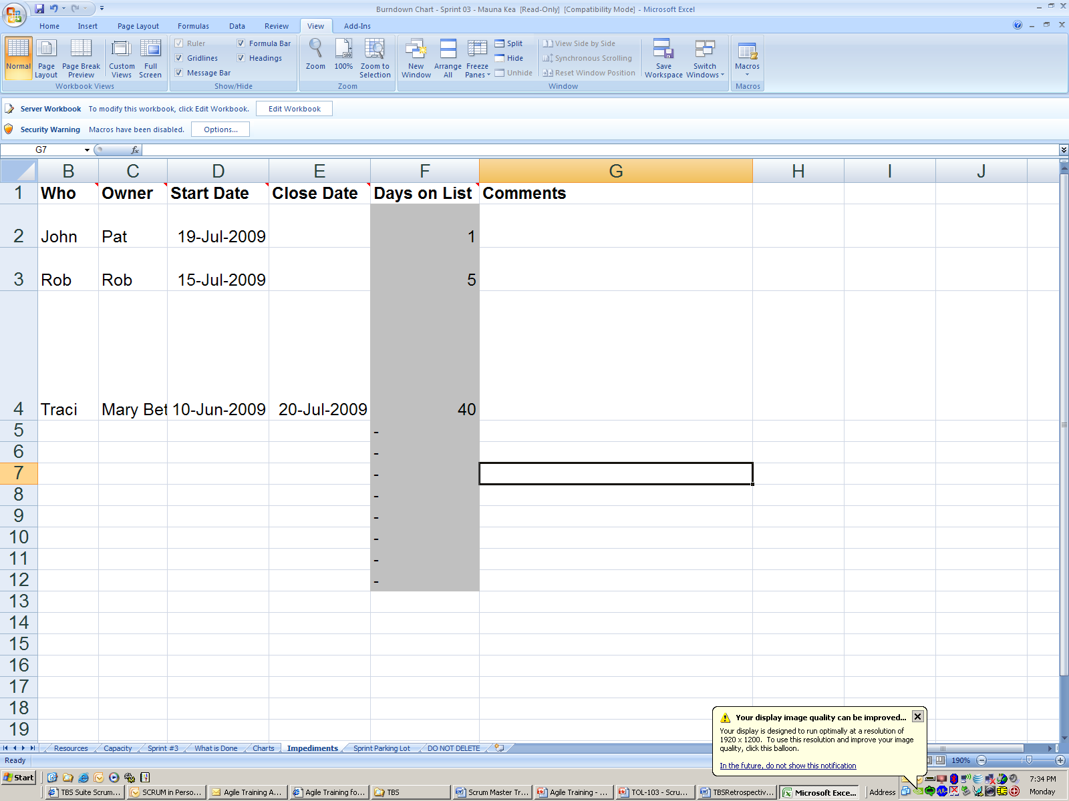
Impediments

Slide 32
Protect the Team
Outside interference can come in many forms:
Team members being asked to work on other projects
Customer support
Anything that diverts their attention from the Sprint

Slide 33



The Team
Development Team
Product
Owner
ScrumMaster

Slide 34














Influence of Stakeholders
Operations
Quality Assurance
Documentation
Development Team
Product
Owner
Marketing
Training
Management
Customer Support
ScrumMaster
Analysts
Project Management
Sales
“Customer Team”

Slide 35
























Even More Stakeholders
Development Team
Competitors
Marketplace
Operations
Quality Assurance
Documentation
End Users
Development Team
Product
Owner
Marketing
Training
Management
Media
Customer Support
ScrumMaster
Analysts
Partners
Project Management
Sales
Shareholders
“Customer Team”
Industry Groups
Regulatory Agencies
“Stakeholder Team”

Slide 36
However, our goal is to act like this with the Team
Development Team
Product
Owner
ScrumMaster

Slide 37
Exercise
Groups of 4-5 people
5 minutes
If you are the Scrum Master, describe how you would handle the following situation and why?
Case Study G:
You have planned a 30-day sprint, and the team has taken on a balanced load of work, so they will need all of their available capacity to complete the user stories. One week into the sprint, a field support issue comes up that demands the attention of both developers on your team. They will both have to travel to the customer site, and could be gone for a week.

Slide 38
Exercise
Groups of 4-5 people
5 minutes
If you are the Scrum Master, describe how you would handle the following situation and why?
Case Study H:
You have planned a 30-day sprint, and the team has taken on a balanced load of work, so they will need all of their available capacity to complete the user stories. One week into the sprint, one of your three developers falls off his bike and breaks both of his wrists.

Slide 39
Protect the Process
If you don’t, who will?
Principles vs. Practices

Slide 40
Coaching
Your role is crucial. You may have a PO or PL who doesn’t really understand this process or doesn’t believe it will work. Members of your team will have line managers who don’t understand what their people are being asked to do.

Slide 41
Preparing for the First Sprint
Get to know your team
Define “What is Done”
Define “What is a One”
Sprint Planning Calendar
Stick to defined time boxes at first

Slide 42
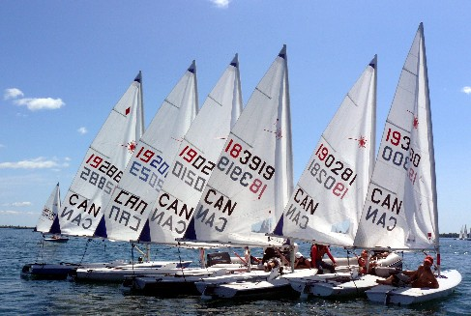
Beyond the Mechanics
“A leader is one who knows the way, goes the way and shows the way” - John Maxwell
Scrum will reveal issues that have been there for a long time and have just been hiding. Do not change Scrum because the issues are painful. It is human nature to avoid pain and conflict, but as a Scrum Master you must face it.
Self directed work teams need good leaders in order to be successful.
Be a good example! It has a big impact on the team.
Notes:
This is an opportunity to address the issues that are holding the team back from optimum performance.

Slide 43
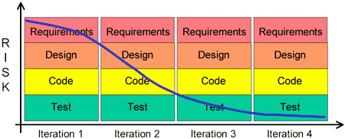
Making the mental shift to Agile
More Important:
Individuals and interactions
Working software
Customer collaboration
Responding to change
Important:
Processes and tools
Comprehensive documentation
Contract negotiation
Following a plan
(Source: The Agile Manifesto - http://agilemanifesto.org/ )

Slide 44
Exercise
Groups of 4 or 5 people
5 minutes
Answer this question: “What are the characteristics and qualities of a successful Scrum Master?”

Slide 45
Characteristics of the Scrum Master
Helping the team to find their way by using…
Facilitation skills
The right attitude about Scrum and it’s principles
Belief in self-directed teams
Ability to motivate others without authority
Coaching skills
Willingness to serve
Ability to play multiple roles effectively
Understanding of team dynamics (forming, storming, norming, performing)
“To lead people, walk beside them ...
As for the best leaders, the people do not notice their existence.
The next best, the people honor and praise.
The next, the people fear;
and the next, the people hate ...
When the best leader's work is done the people say "We did it ourselves!"
- Lao-tsu
Notes:
We don’t sacrifice principles for practices
coaching: drawing out the quiet people, looking for the natural leaders to emerge, etc.
Belief that people can manage their own work
Helping the team to find their way

Slide 46
Exercise
Groups of 4-5 people
5 minutes
If you are the Scrum Master, describe how you would handle the following situation and why?
Case Study I:
Your team consists of 4 developers, 2 testers, and 1 writer. During Sprint Planning meeting #2 it becomes obvious that the work taken into the sprint consists of far more testing tasks than anything else. This leads to a situation where the testers are over capacity and the developers and writers are under capacity. The developers suggest working ahead on development tasks for stories that are not part of the sprint so that they can stay productive.

Slide 47
Exercise
Groups of 4-5 people
5 minutes
If you are the Scrum Master, describe how you would handle the following situation and why?
Case Study J:
One of the stories in your sprint requires a hardware engineer, firmware engineer, and applications engineer to fully implement it. They understand that Scrum wants you to share tasks, but simply don’t have the ability to do each other’s job.

Slide 48
Exercise
Groups of 4-5 people
5 minutes
If you are the Scrum Master, describe how you would handle the following situation and why?
Case Study K:
The Product Owner is consistently late, and sometimes doesn’t even show up for Planning Meetings. The Technical Lead has tried to keep things moving by answering the Team’s questions. You, as the Scrum Master, are not comfortable with the situation but allowed the meeting to progress. During the Demo, the Product Owner disagrees with the way one of the stories was implemented, and refuses to accept the feature as complete.

Slide 49
Exercise
Groups of 4-5 people
5 minutes
If you are the Scrum Master, describe how you would handle the following situation and why?
Case Study L:
Your team consists of 3 developers, 2 functional testers, 1 system tester, and 1 tech writer. They have consistently taken 20 story points each sprint, and always complete all their tasks. The team works well together, and is proud of the fact that they rarely have to work overtime. The release plan is showing that the project is on track, and the project is on budget. Your manager asks you how you know if they’re working to their full potential.

Slide 50
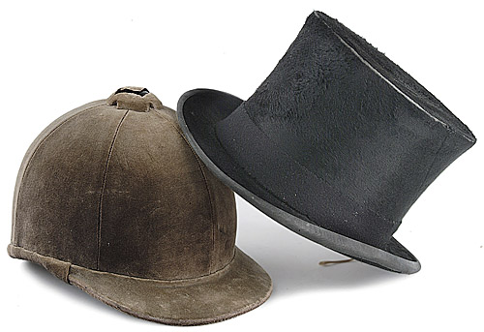
The Role of the Scrum Master…
… is unique in the organization.
It is distinct from the Project Leader role, the Lead role, etc. However, one person could perform multiple roles on the project. In this case it is important to distinguish the Scrum Master role from the other roles.
Coaching is available
Notes:
Ask about interest in Monthly Scrum Master lunches

Slide 51

Q & A
Questions and Answers?

Slide 52
THANK YOU

